Slide 1
From zero to sixty with Oracle APEX
Paramaribo, mei 2019
http://bit.do/apexws0-60
Apex.oracle.com

Slide 2
Zero to sixty?
Car metaphor
Under the hood
Admiring Legacy
Mobile phone while driving
Questions after instructions
Pit stops
Drivers

Slide 3
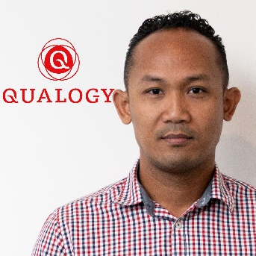
Your Navigator
Sullivan Kromosoeto
Mechanical Engineer turned Database Developer/ APEX Specialist
10 years experience
Retail, Insurance, Banking
QSR to QNL
Currently at AS Watson
Knowledge sharing, Travel, Fitness

Slide 4
Your Pit Crew
QSR, Nilesh, Felicia, Shane, Michelle
Rudennis, Jane, Anuradha
Combined experience min 20 years
Daily drivers

Slide 5
Get In
Apex.oracle.com
http://bit.do/apexws0-60
Workspace
App Builder
SQL Workshop
Team Development
App Gallery
Good to know
Run time environment vs App Builder
Region
Items
Shared Components

Slide 6
Take off
Import all apex apps
Instructions.txt
Drive

Slide 7
Finish
First but not last race
Pit Party

Slide 8
Thank You!

